Slide 1
Predicting Return of Macau Gaming Patron
– RFM as Feature Engineering
Technical Sharing Meeting
2022/11/17

Slide 2
Index
Predicting Return of Macau Gaming Patron
Define the Problem
Road Map for building the ML Model
Feature Engineering
Model Training
Evaluation
Improvement

Slide 3
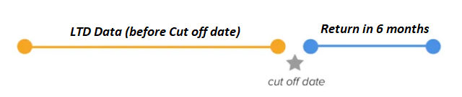
Define the Problem
Using Machine Learning Model to Predict Return of Macau Gaming Patron
Basic info:
Using data prior to 2022 May to predict return in next 6 months (2022 May to Oct)
How to define Return?
Target/ Response: Having Gaming Trip in 2022 May to Oct then 1 (returned) else 0
So, it’s a CLASSIFICATION PROBLEM

Slide 4
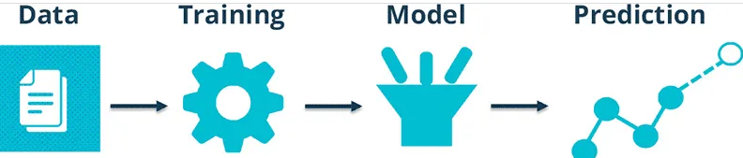
Road Map for building the ML Model
Data : Gaming Records, Trip Records, Geographic Information
Feature Engineering
1. RFM as basic features
2. Categorical features (mostly Geographic information)
3. Seasonal Visitor (Golden Week)
Training / Model : Xgboost

Slide 5
Feature Engineering
RFM (Recency, Frequency and Monetary Value)
Recency – the last Gaming Date prior to 2022 May
Frequency – how many trips prior to 2022 May
Monetary – how much spent (theo.win) prior to 2022 May
Geographic Information
Mobile Province
Age
Sign Up Year
Seasonal Visitor
Visited in past Golden Weeks

Slide 6
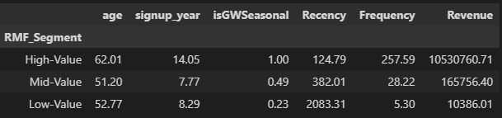
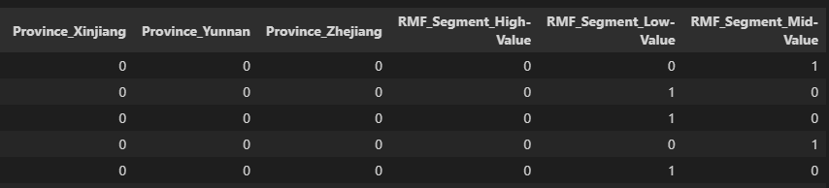
Feature Engineering
Create RFM Segment Variable
Use pandas get_dummies() to transform categorical features into 0/1

Slide 7
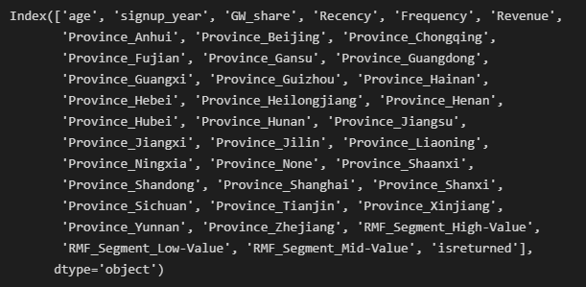
Feature Engineering
Final Training/Testing Data Input (80% as training and 20% as testing)

Slide 8
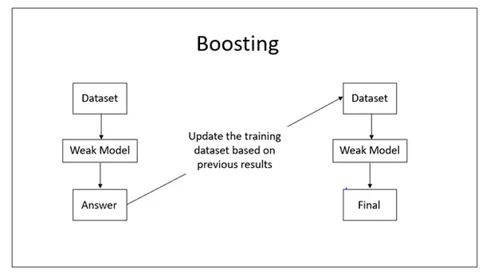
Training - Model
What is XgBoost and why do we need to specify the number of rounds?
XGBoost stands for “Extreme Gradient Boosting”, where the term “Gradient Boosting” is as follow
Weak Model - really short and simple decision tree. Each tree is called a “weak learner” for their high bias. So, it’s another type of Ensemble Tree Method.
Measure how bad previous model done

Slide 9
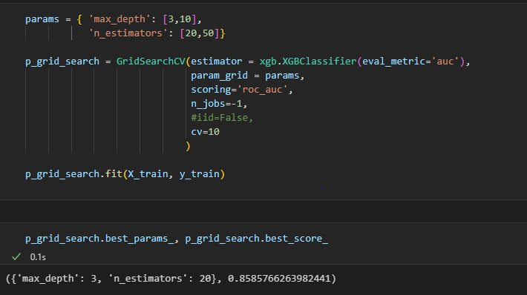
Training - Tuning
Use Xgboost as model for training
GridSearchCV with k-Fold Cross Validation for tuning and evaluation within training set.

Slide 10
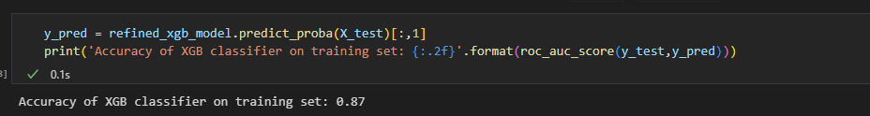
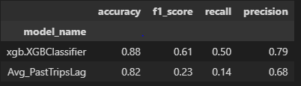
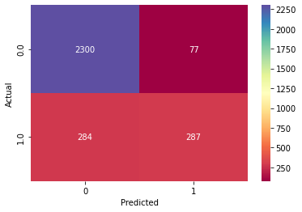

Evaluation
High AUC score for the model itself.
But does it work better than simple method (e.g. avg. of past trips day lag)?
Using Model has a much higher recall!
Recall tells you how many return you predicted out of the actual returned
Xgboost Model

Slide 11
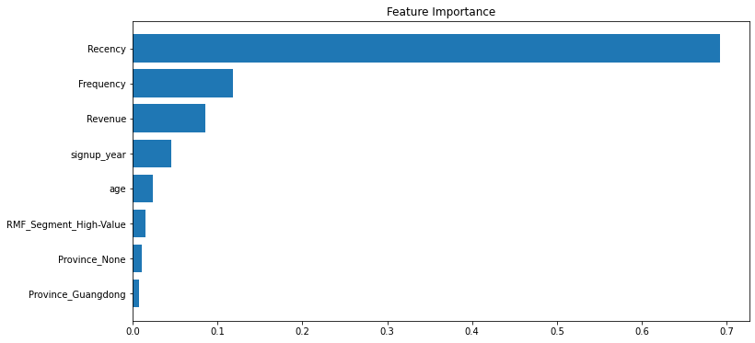
Evaluation – Feature Importance
RFM has the most significant impact on prediction.

Slide 12
Improvement
Adding more features
More feature engineering
Trying other models
Hyper-parameter tuning

Slide 13
Thanks!

